Slide 1
Ansible on Taito
Martin Matthisen, Ansible Hands-on Intro Workshop 14.6.2018

Slide 2
Contents
Background
Why Ansible on Taito?
How?
Compiling a complex tool
Compiling a simple tool (with live demo)
Questions?

Slide 3
Traditional software stack management on HPC (Taito)
For the Language Bank: /appl/ling/
drwxrwsr-x 4 matthies csc 4096 Jan 24 11:32 ffmpeg
Sometimes also /opt
drwxrwxr-x 3 matthies csc 4096 Jan 22 15:02 nasm
Process:
Get hands on source
Compile
Install
Fix permissions
Register as module

Slide 4
Why Ansible on Taito
Reproducability:
compilation steps
hacks
download locations
Automatic checklist
Tests
Fix permissions
Partial configuration management
”Track changes”

Slide 5
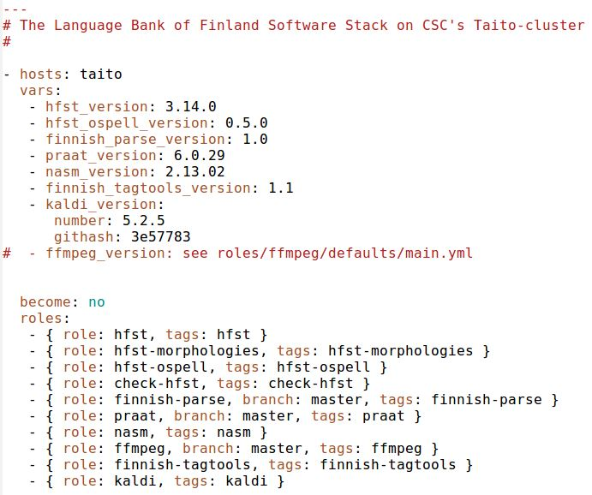
The stack described in one file
https://github.com/CSCfi/Kielipankki-palvelut
servers/taito/site.yml

Slide 6
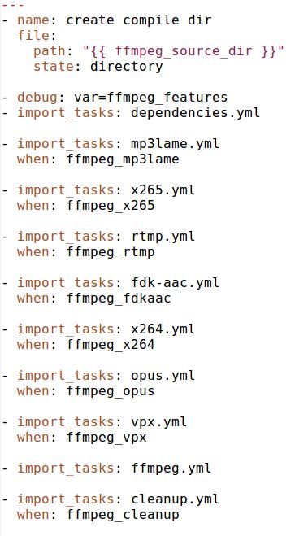
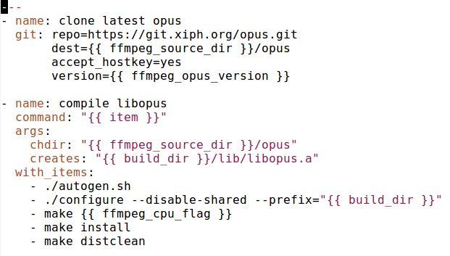
How? A complex example (ffmpeg)
https://github.com/CSCfi/Kielipankki-palvelut
servers/taito/roles/ffmpeg/tasks/main.yml

Slide 7
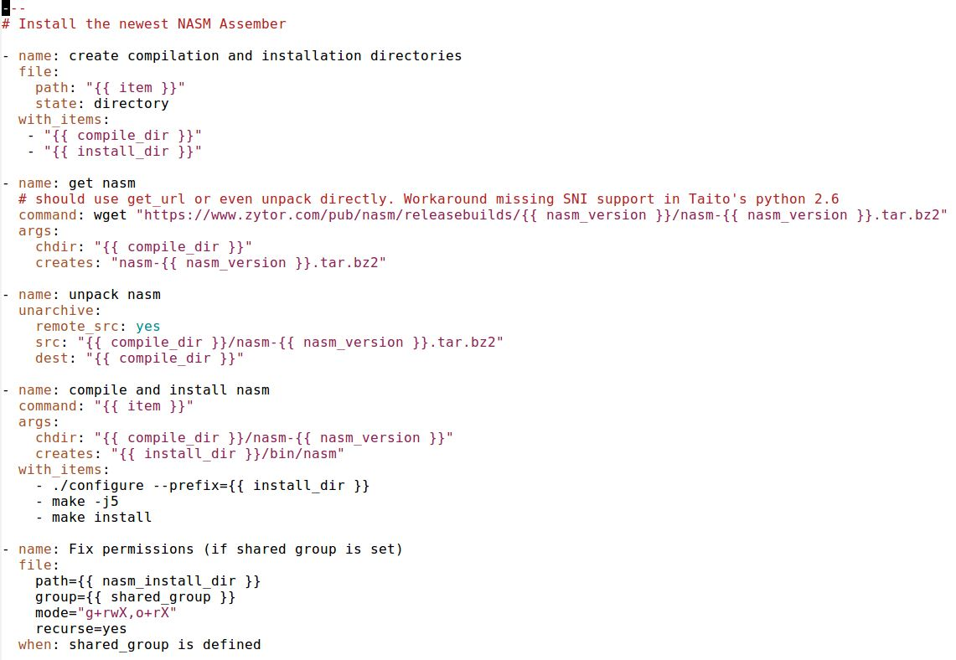
An easier example: The Netwide Assembler (NASM)
https://github.com/CSCfi/Kielipankki-palvelut
servers/taito/roles/nasm/tasks/main.yml

Slide 8
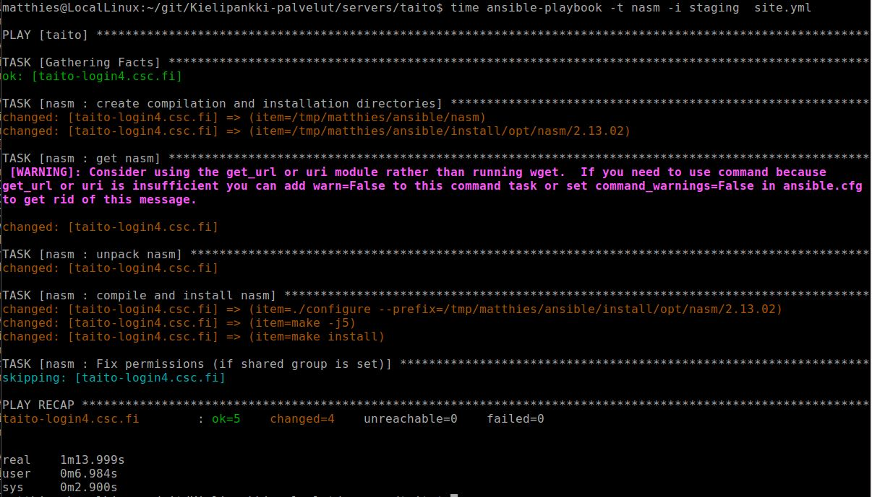
A live demo and time for questions

Slide 9
Thank you!
Questions, comments?

